Slide 1



Crime Analysis
View in Power BI
Last data refresh:
5/27/2022 12:04:39 PM UTC
Downloaded at:
5/27/2022 12:06:42 PM UTC

Slide 2
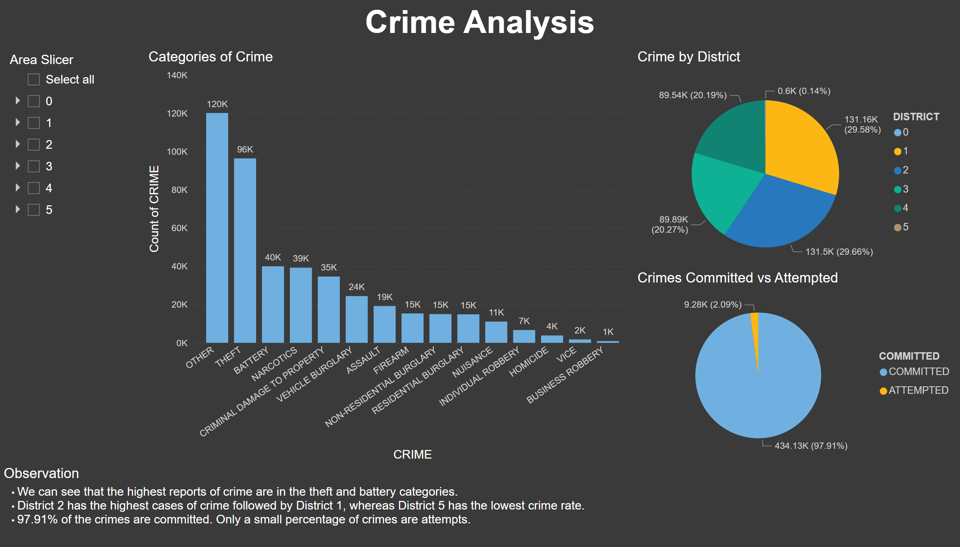
Part 1
Notes:
Categories of Crime
No alt text provided
textbox
No alt text provided
a
No alt text provided
Crime by District
No alt text provided
Crimes Committed vs Attempted
No alt text provided
Observation
No alt text provided

Slide 3
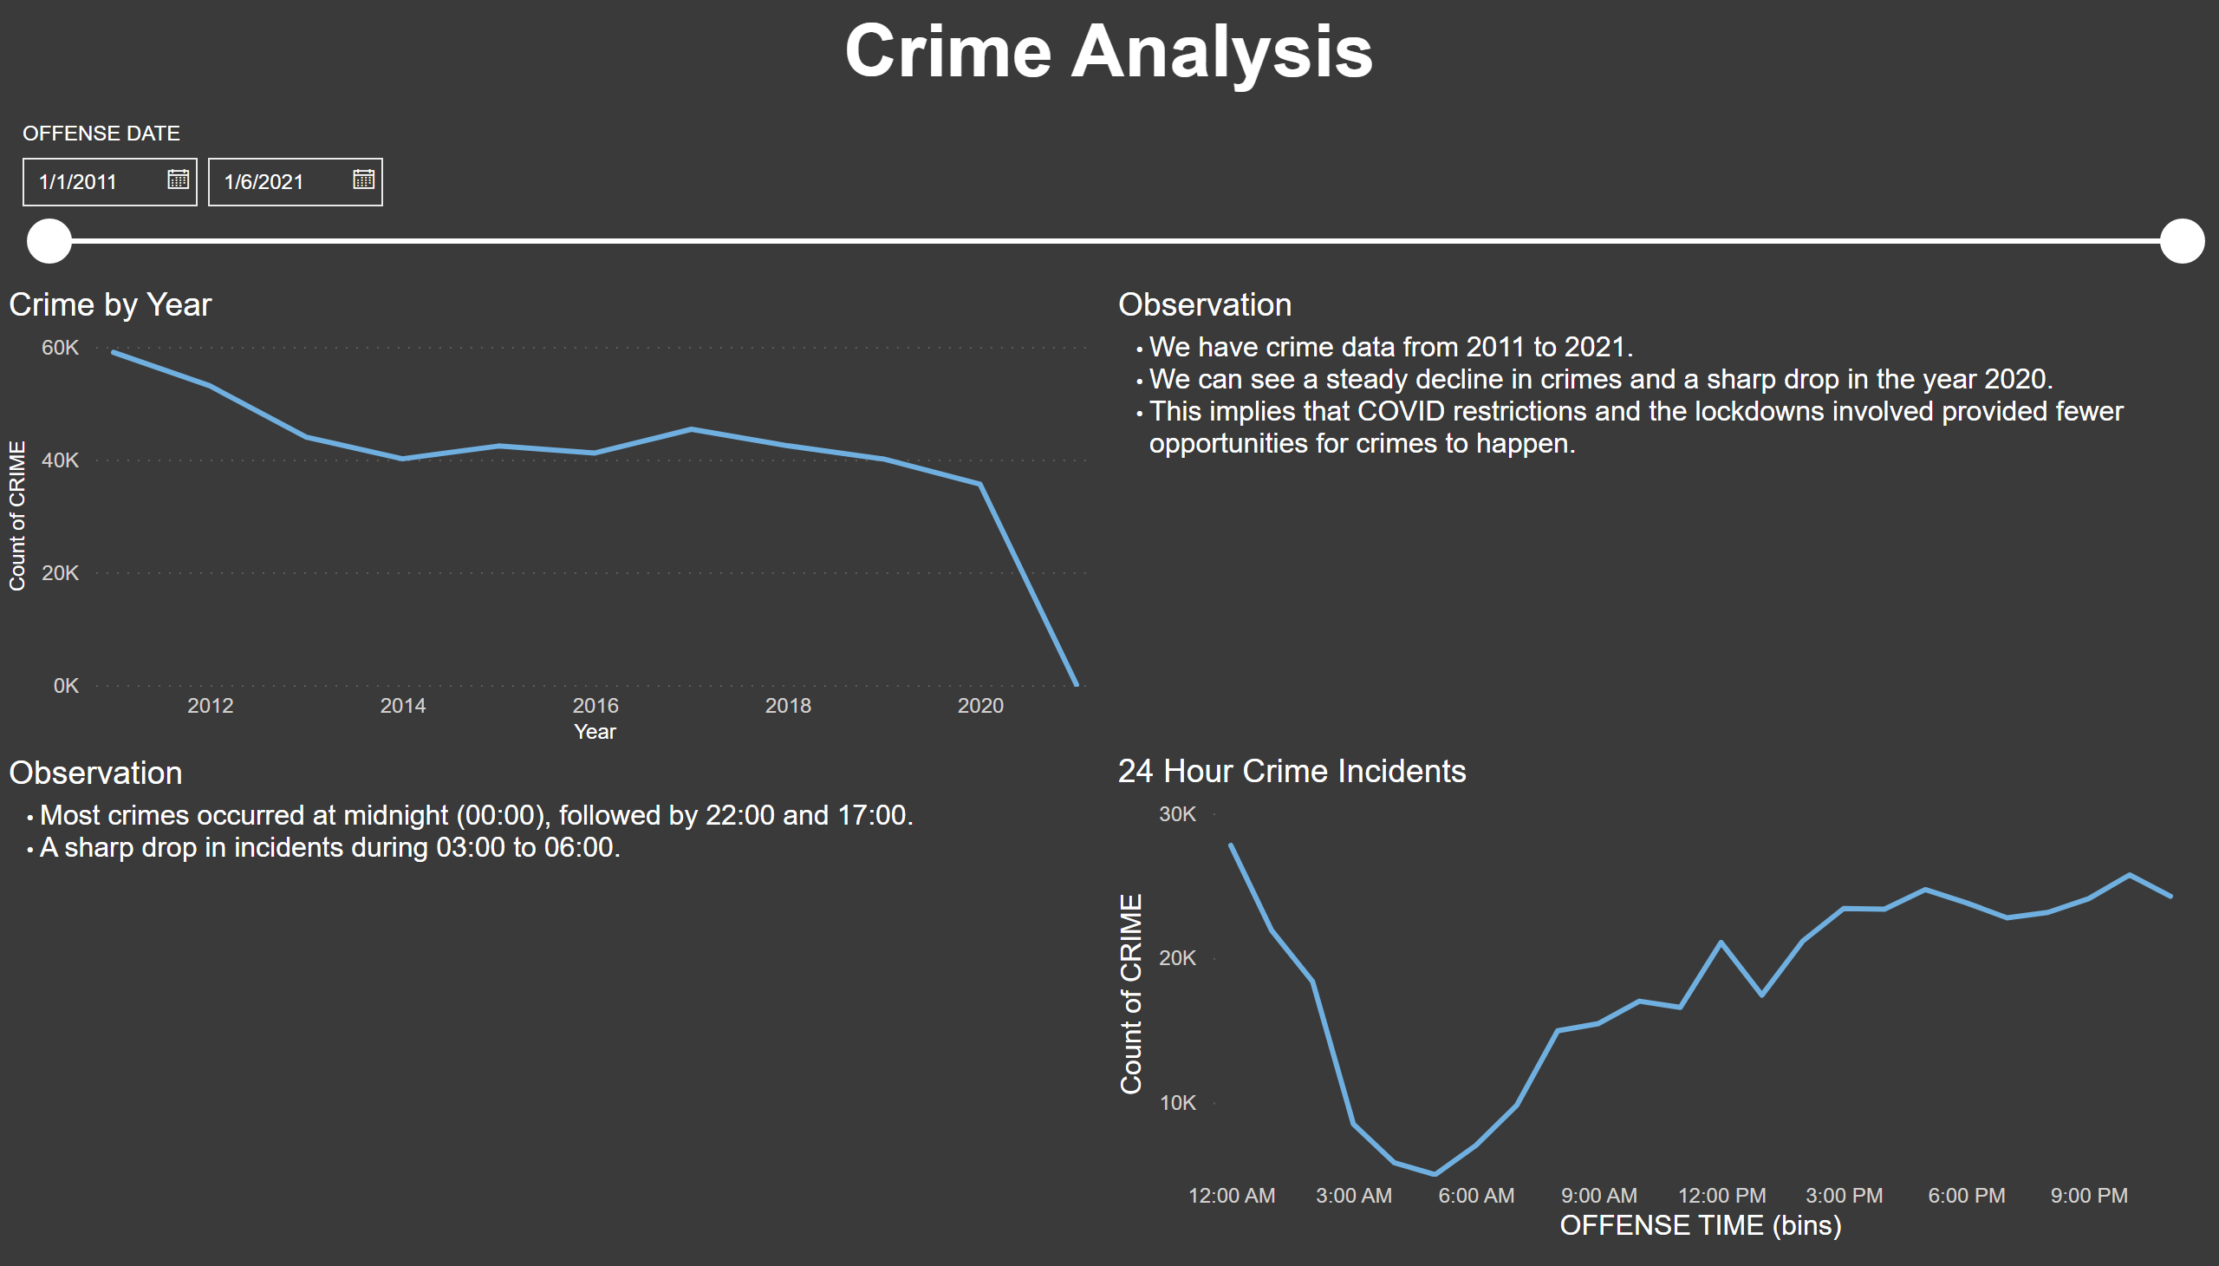
Part 2
Notes:
Crime by Year
No alt text provided
24 Hour Crime Incidents
No alt text provided
textbox
No alt text provided
Observation
No alt text provided
slicer
No alt text provided
Observation
No alt text provided

Slide 4
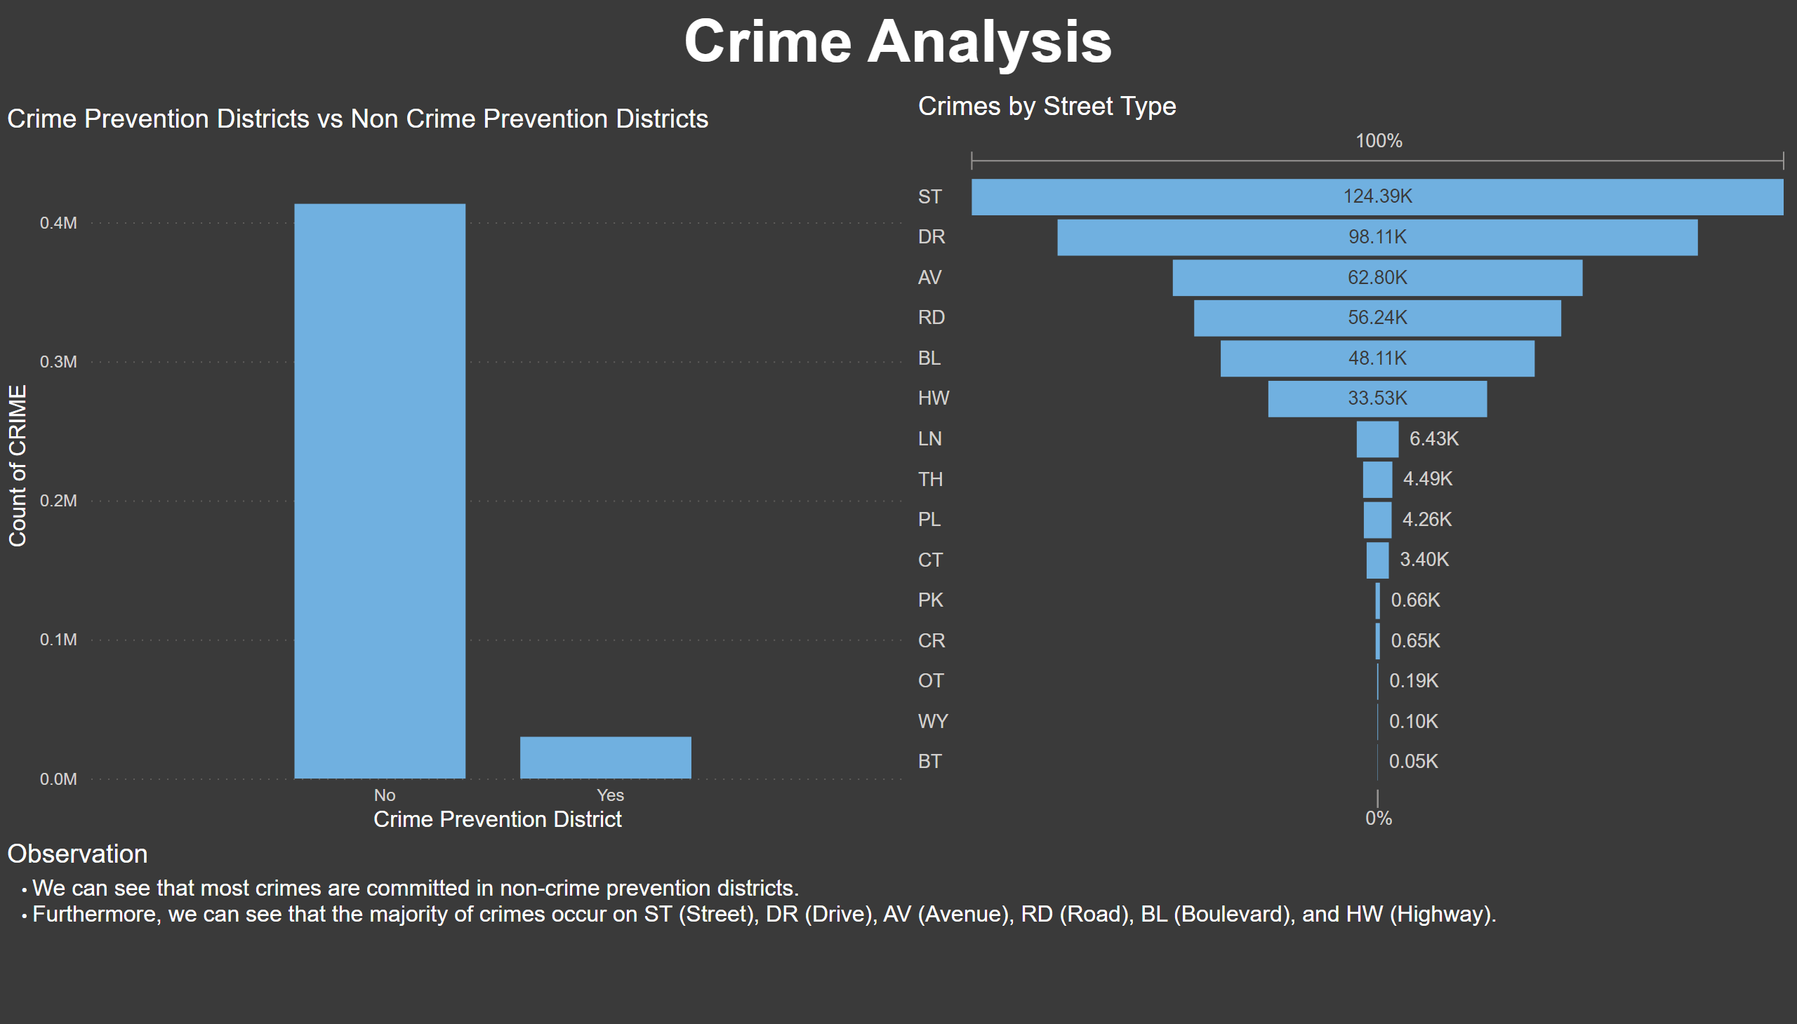
Part 3
Notes:
Crimes by Street Type
No alt text provided
Crime Prevention Districts vs Non Crime Prevention Districts
No alt text provided
textbox
No alt text provided
Observation
No alt text provided

Slide 5
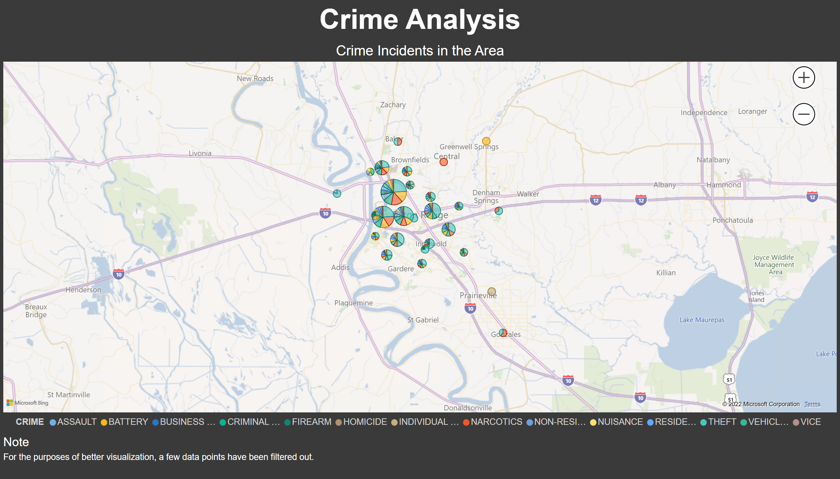
Part 4
Notes:
Crime Incidents in the Area
No alt text provided
textbox
No alt text provided
Note
No alt text provided

Slide 6
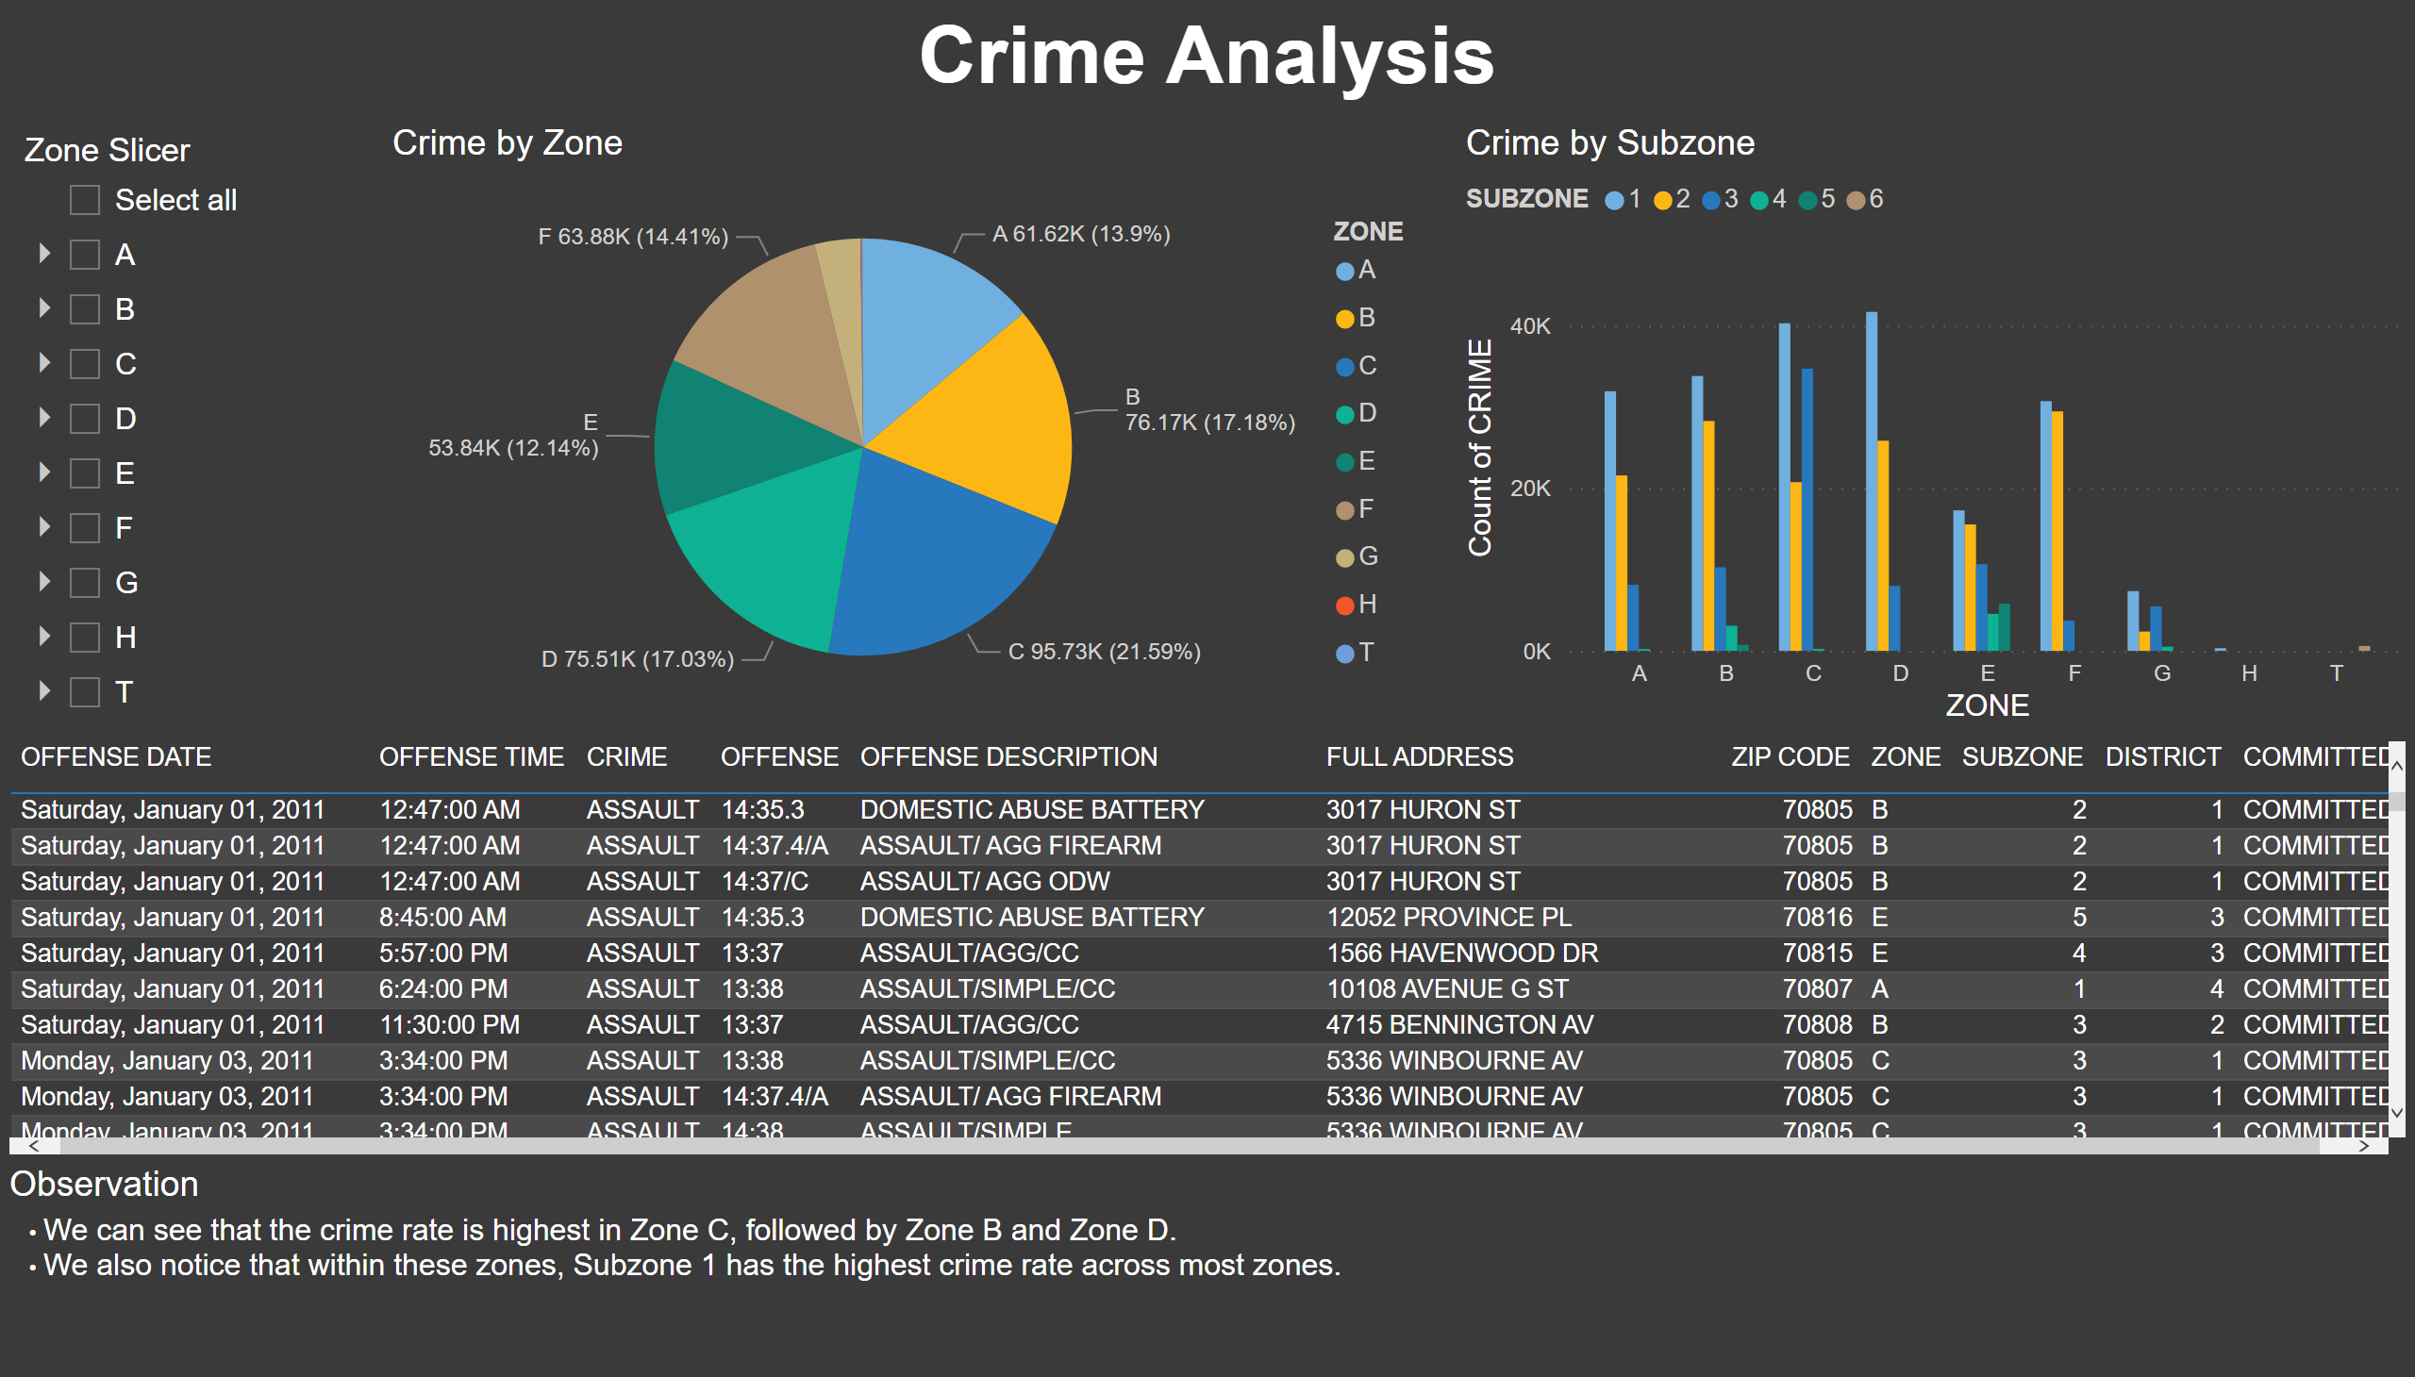
Part 5
Notes:
Crime by Zone
No alt text provided
Crime by Subzone
No alt text provided
tableEx
No alt text provided
slicer
No alt text provided
textbox
No alt text provided
Observation
No alt text provided

Slide 7
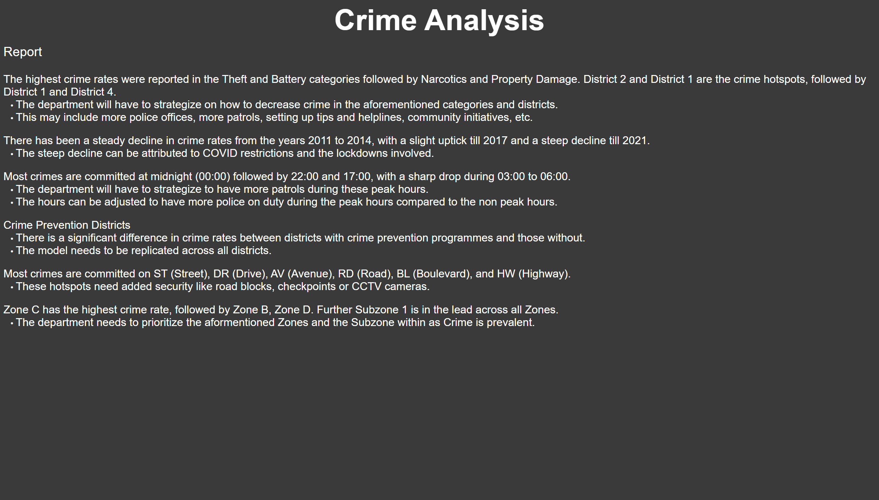
Report
Notes:
textbox
No alt text provided
Report
No alt text provided

